Slide 1
RECOMMENDATION SYSTEM

Slide 2
Recommender systems are the systems that are designed to recommend things to the user based on many different factors.
These systems predict the most likely product that the users are most likely to purchase and are of interest to.
Companies like Netflix, Amazon, etc. use recommender systems to help their users to identify the correct product or movies for them.

Slide 3
The recommender system deals with a large volume of information present by filtering the most important information based on the data provided by a user and other factors that take care of the user’s preference and interest.
It finds out the match between user and item and computes the similarities between users and items for recommendation.
User preferences can be acquired implicitly by monitoring user behavior, but the recommender system might also explicitly ask the visitor about his or her preferences

Slide 4
Explicit Data:
Explicit signals or input is where a user directly gives feedback to a particular item/product.
This can be star values, say in the range of 1 to 5 or just a binary 1(like) and 0(dislike).
For example, when we rate an item on Amazon or when we rate a movie on IMDb these are explicit signals where we are directly giving our feedback towards an item.
.

Slide 5
One thing to keep in mind is that we should be aware that each and every individual is not the same, i.e. for an Item X, User A, and User B can have different ratings, User A can be generous with his ratings and can give a rating of 5 stars whereas, User B is a critic and gives Item X 3.5 stars and gives 5 stars only for exceptions Items

Slide 6
Implicit Data:
Implicit signals are obtained by capturing a user’s interaction with the item.
This can be a continuous value, like the number of times a user has clicked on an item or the number of times a user has watched an Action movie or Binary, similar to just clicked or not clicked.
For example, while scrolling through amazon.com the amount of time spent viewing an item or the number of times you have clicked the item can act as implicit feedback.

Slide 7
Types of recommendation system
Collaborative recommendation-(Memory based and Model-based)
Content-based
Knowledge-based
Hybrid approaches

Slide 8
Collaborative Filtering
User similarity
The basic idea of these systems is that if users shared the same interests in the past – if they viewed or bought the same books, for instance – they will also have similar tastes in the future
Based on similarity between users preferences (and not on users attributes like gender, age).
So, we figure out similar users based on their preference and eventually whatever the 1st user has consumed, will be suggested to the other users and vice-versa.

Slide 9
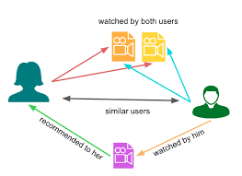

Slide 10
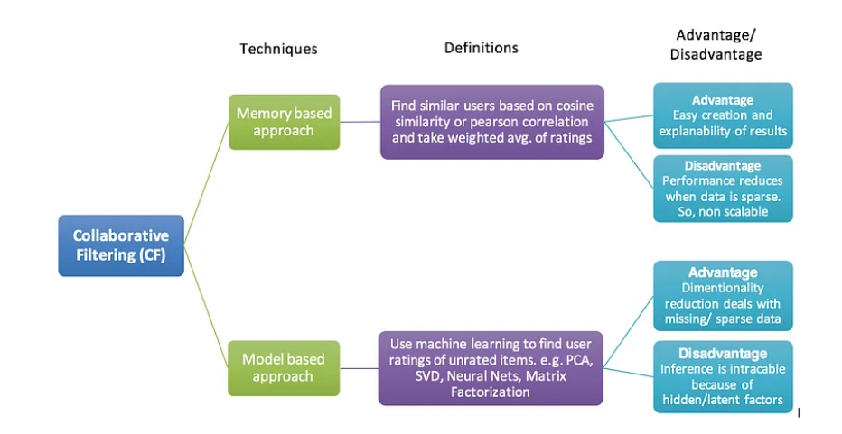
Types of CF approaches

Slide 11
Content-based recommendation:
Item description and user preferences
These systems are based on the idea that a user’s preferences can be predicted based on their previous interactions with items, such as their viewing and purchasing history.
The goal of a content-based recommendation system is to recommend items to a user that are similar to items that they have previously interacted with.
So if you have been watching Action movies, similarity with those Action-Movies will be checked in the Movies db and eventually similar movies will be recommended.

Slide 12
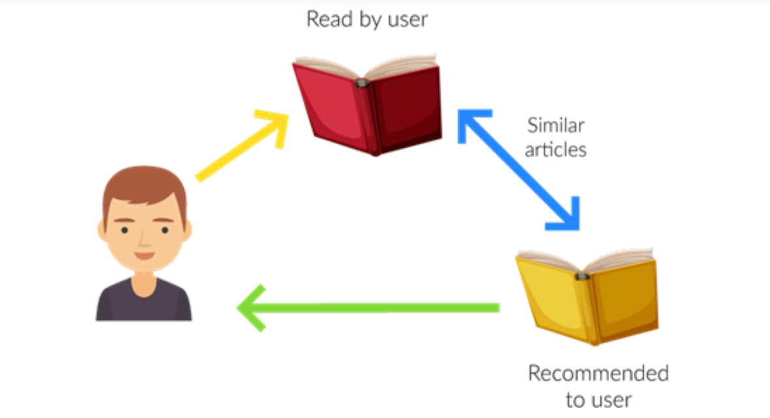

Slide 13
Knowledge-based recommendation:
A recommender system is knowledge-based when it makes recommendations based not on a user’s rating history, but on specific queries made by the user.
In domains, such as consumer electronics, many involve large numbers of one-time buyers.
This means that we cannot rely on the existence of a purchase history
Take, for instance, a recommender system for digital cameras that should help the end user ﬁnd a camera model that ﬁts his or her particular requirements.

Slide 14
In the digital camera domain, a constraint-based system could use detailed knowledge about the features of the cameras, such as resolution, weight, or price.
In addition, explicit constraints may be used to describe the context in which certain features are relevant for the customer, such as, for example, that a high resolution camera is advantageous if the customer is interested in printing large pictures

Slide 15
Hybrid recommendation
Hybrid mechanisms to predict recommendation, as the name implies, combine two or more recommendation techniques.
combine different techniques to generate better or more precise recommendations

Slide 16
Collaborative recommendation(Memory-based)
Here the main idea is to exploit information about the past behavior or the opinions of an existing user community for predicting which items the current user of the system will most probably like or be interested in.
It takes a matrix of given user–item ratings as the only input and typically produce the following types of output
:(a)a (numerical) prediction indicating to what degree the current user will like or dislike a certain item and
(b) a list of n recommended items.
Such a top-N list should, of course, not contain items that the current user has already bought

Slide 17
2 types
User-based nearest neighbor recommendation
Item based nearest neighbour recommendation

Slide 18
User-based nearest neighbor recommendation:
Given a ratings database and the ID of the current (active) user as an input, identify other users (peer users or nearest neighbors) that had similar preferences to those of the active user in the past.
Then, for every product p that the active user has not yet seen, a prediction is computed based on the ratings for p made by the peer users.
Assumptions of such methods are that
(a) if users had similar tastes in the past they will have similar tastes in the future and
(b) user preferences remain stable and consistent over time.

Slide 19
Example:
Table 2.1 shows a database of ratings of the current user, Alice, and some other users.
Alice has, for instance, rated “Item1” with a “5” on a 1-to-5 scale, which means that she strongly liked this item.
The task of a recommender system in this simple example is to determine whether Alice will like or dislike “Item5”, which Alice has not yet rated or seen.

Slide 20
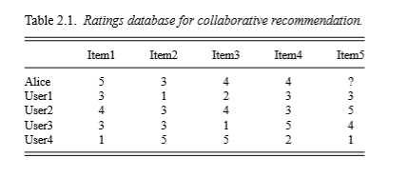
If we can predict that Alice will like this item very strongly, we should include it in Alice’s recommendation list.

Slide 21
U ={ u1,...,un} to denote the set of users
P ={p1,...,pm} for the set of products (items)
R as an n×m matrix of ratings ri,j, with i ∈ 1...n,j∈ 1...m.
The possible rating values are deﬁned on a numerical scale from 1 (strongly dislike) to 5 (strongly like).
If a certain user i has not rated an item j, the corresponding matrix entry ri,j remains empty.
To find the set of similar users, one common measure used in recommender systems is Pearson’s correlation coefﬁcient.
The similarity sim(a,b) of users a and b, given the rating matrix R, is deﬁned in Formula 2.1. The symbol ra corresponds to the average rating of user a.

Slide 22


Slide 23
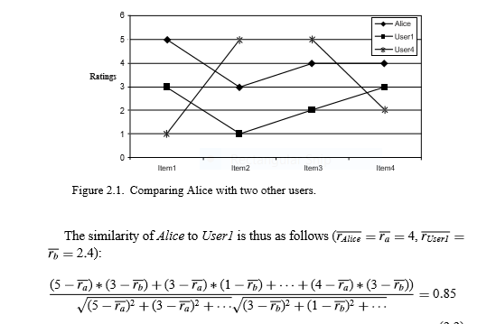

Slide 24

The Pearson correlation coefﬁcient takes values from +1 (strong positive correlation) to −1 (strong negative correlation).
The similarities to the other users, User2 to User4, are 0.60, 0.00, and−0.79, respectively.
User1 and User2 as peer users to predict Alice’s rating. A possible formula for computing a prediction for the rating of user a for item p that also factors the relative proximity of the nearest neighbors N and a’s average rating is the following:

Slide 25
The prediction for Alice’s rating for Item5 based on the ratings of near neighbors User1 and User2 will be
4+1/(0.85+0.7)∗(0.85∗(3−2.4)+0.70∗(5−3.8)) = 4.87
where r_{user1}= 2.4 and r_{user2}=3.8
We can now compute rating predictions for Alice for all items she has not yet seen and include the ones with the highest prediction values in the recommendation list.
It will most probably be a good choice to include Item5 in such a list.

Slide 26
Item based nearest neighbour recommendation
The main idea of item-based algorithms is to compute predictions using the similarity between items and not the similarity between users.
Examine the ratings database again and make a prediction for Alice for Item5.

Slide 27
First compare the rating vectors of the other items and look for items that have ratings similar to Item5.
In the example, the ratings for Item5 (3,5,4,1) are similar to the ratings of Item1 (3,4,3,1) and there is also a partial similarity with Item4(3,3,5,2).
The idea of item-based recommendation is now to simply look at Alice’s ratings for these similar items. Alice gave a “5” to Item1 and a “4” to Item4.
An item-based algorithm computes a weighted average of these other ratings and will predict a rating for Item5 somewhere between 4 and 5.

Slide 28
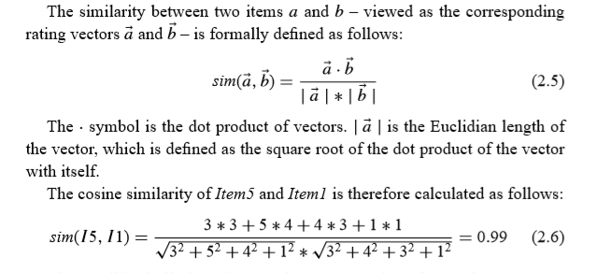
The cosine similarity measure:

Slide 29

The possible similarity values are between 0 and 1, where values near to 1 indicate a strong similarity.
The basic cosine measure does not take the differences in the average rating behavior of the users into account.
This problem is solved by using the adjusted cosine measure, which subtracts the user average from the ratings. The values for the adjusted cosine measure correspondingly range from−1 to+1.
Let U be the set of users that rated both items a and b. The adjusted cosine measure is then calculated as follows:

Slide 31
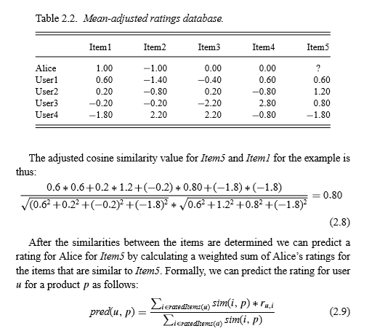

Slide 32
Now after understanding both of them you may be wondering which to use when.
Here is the solution if No. of items is greater than No. of users go with user-based collaborative filtering as it will reduce the computation power.
If No. of users is greater than No. of items go with item-based collaborative filtering.
For Example, Amazon has lakhs of items to sell but has billions of customers. Hence Amazon uses item-based collaborative filtering because of less no. of products as compared to its customers.

Slide 33
Preprocessing data for item-based ﬁltering
Challenges with User-Based Collaborative Filtering:
Scalability Issues: Traditional user-based collaborative filtering doesn't handle large datasets well. For millions of customers (M) and millions of items (N), computational complexity is high, even if each customer rates only a few items.
Real-Time Limitations: Calculating predictions in real-time for millions of users is infeasible due to the short response times required for online systems.

Slide 34
Item-Based Collaborative Filtering Solution
Offline Precomputation:
An item similarity matrix is created in advance. This matrix stores the pairwise similarity between all items, reducing the need for heavy computations during runtime.
At runtime, predictions for a product are calculated using the most similar items to the product and the user's ratings for those items.
Efficiency at Runtime:
The computation is limited to items the user has interacted with, which keeps the calculations manageable.

Slide 35
Implicit and explicit ratings
Explicit rating
Asking for explicit item ratings is probably the most precise one.
In most cases, ﬁve-point or seven-point Like response scales ranging from“Strongly dislike”to“Strongly like” are used; they are then internally transformed to numeric values so the previously mentioned similarity measures can be applied.
Some aspects of the usage of different rating scales, such as how the users’ rating behavior changes when different scales must be used and how the quality of recommendation changes when the granularity is increased,
What has been observed is that in the movie domain, a ﬁve-point rating scale may be too narrow for users to express their opinions, and a ten-point scale was better accepted

Slide 36
The main problems with explicit ratings are that such ratings require additional efforts from the users of the recommender system and users might not be willing to provide such ratings as long as the value cannot be easily seen.
Thus, the number of available ratings could be too small, which in turn results in poor recommendation quality.

Slide 37
Implicit ratings
Implicit ratings are typically collected by the web shop or application in which the recommender system is embedded.
When a customer buys an item, many recommender systems interpret this behavior as a positive rating.
The system could also monitor the user’s browsing behavior. If the user retrieves a page with detailed item information and remains at this page for a longer period of time, for example , a recommender could interpret this behavior as a positive orientation toward the item.

Slide 38
Although implicit ratings can be collected constantly and do not require additional efforts from the side of the user, one cannot be sure whether the user behaviour is correctly interpreted.
A user might not like all the books he or she has bought; the user also might have bought a book for someone else.
Still, if a sufficient number of ratings is available, these particular cases will be factored out by the high number of cases in which the interpretation of the behaviour was right.

Slide 39
Advantages of Collaborative Filtering(CF)
No domain knowledge is required since all the features are learned automatically.
Can help users discover new interests even if they’re not actively searching for them by recommending new items similar to what they’re interested in.
Does not require in-detail features and contextual data of products or items. It only needs the user-item interaction matrix to train the matrix factorization model.

Slide 40
Disadvantages of Collaborative Filtering
1)Data Sparsity and cold-start problem:
Data sparsity is seen as a key disadvantage of collaborative filtering.
Typically, it can cause the cold start problem that describes the difficulty of CF making recommendations when the users or the products are new.
The operation of CF is based on historical data of site interactions between users and items.
But new users and items simply do not have enough historical data (data sparsity) to make it work.
Consequently, due to this limitation of CF, you might fail to provide new customers with a delightful, personalized shopping experience and struggle to leave them with a good impression of your brand.

Slide 41
2)Scalability:
Traditional CF algorithms often suffer serious scalability problems.
As the number of users increases and the amount of data expands, collaborative algorithms will begin to suffer a decrease in performances simply due to the sheer increase in data volume.

Slide 42
3)Lack of diversity in the long run:
In principle, collaborative filters are expected to enhance diversity as they help consumers discover more products, but some may unintentionally do the complete opposite.
Because this approach recommends products based on historical ratings or sales, it will not recommend products with little or limited historical data.
The fact of more users viewing and buying a popular product will make it even more popular and make new items sit in the shadow behind these best-selling items.
In short, this approach can create a rich-get-richer effect for popular products, resulting in a lack of diversity.

